Slide 1


Writing & developing an Effective Résumé!
BUSINESS COMMUNICATION
Department of English
A I U B

Slide 2
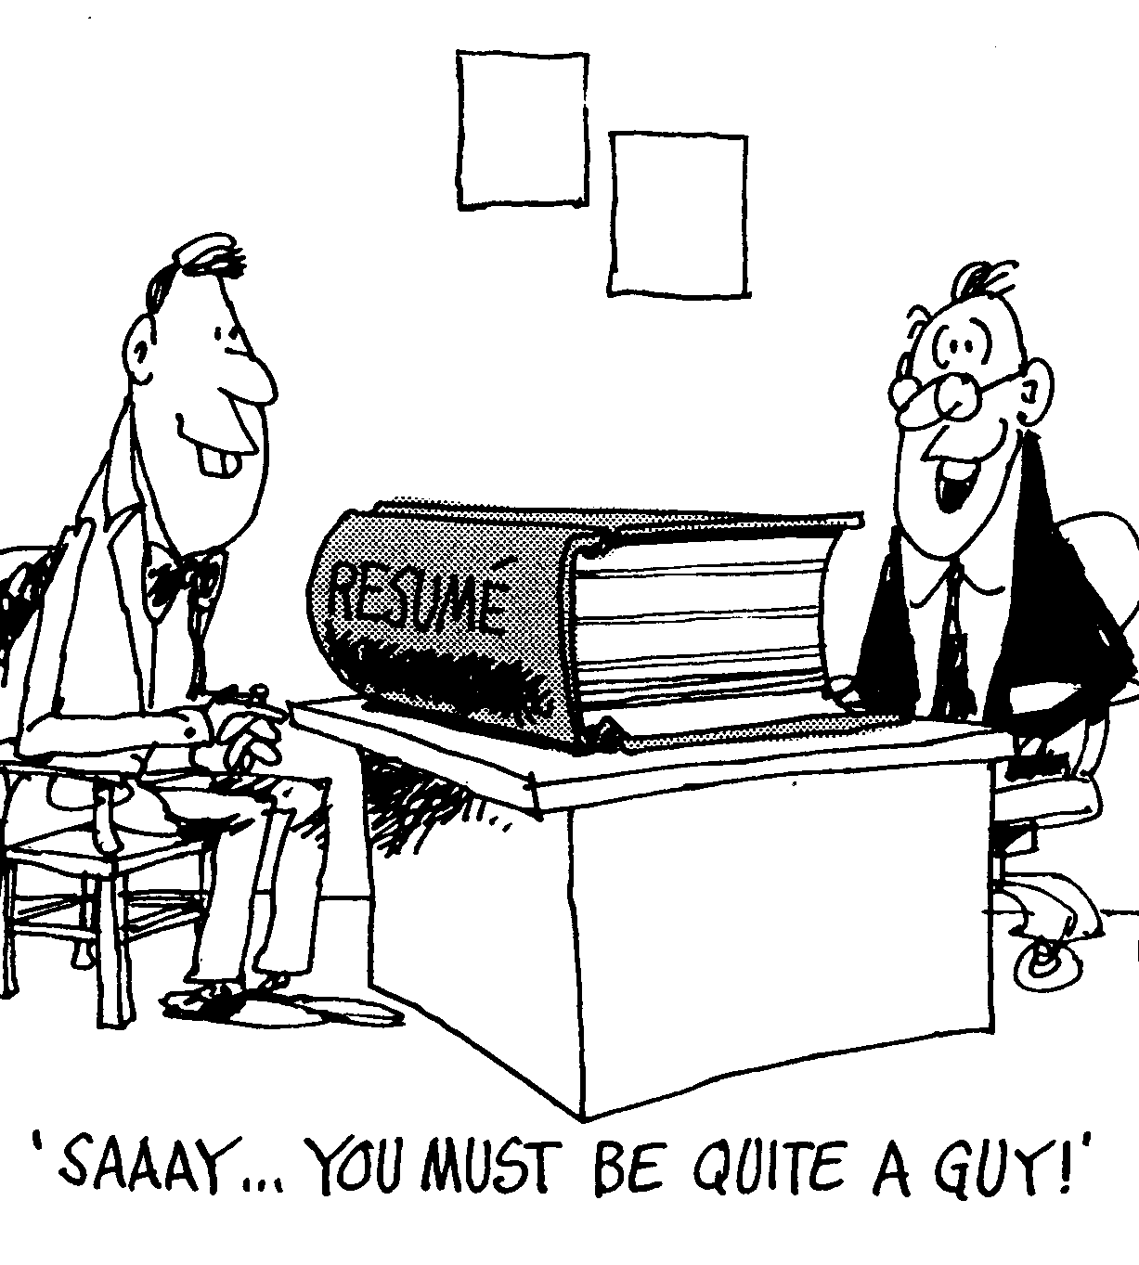
Employers receive dozens of résumés
for a position.
How do you get an employer
to notice yours?
Is this at all the right way??

Slide 3
The 30-Second Scan
In a 30-second scan of your résumé, an employer would check if your résumé consists of-
Concise and well organized information,
Correct punctuation,
Spelling,
Grammar,
Clearly identified strengths and skills, and
Qualifications that match the position’s requirements.

Slide 4

Keys to a
Winning Résumé
Research the position and organization; get a job description, if possible
2.
State your K-A-S-E:
Knowledge - Achievements - Skills - Experience
1. Highlight your qualifications that match the employer’s requirements and needs
Show your achievements and what you are capable of doing as a professional
Design for easy readability

Slide 5

Résumé Formats
Chronological
-Experiences are in reverse, chronological order
-Good choice if you have solid work history
* Format most widely accepted by employers*
Functional
-Concentrates on functional skill areas related to your job objective
-Usually focuses on three skill areas or more
-Work history section may only contain job titles
Combination
(Chronological/Skill-based)
-Has skills, relevant experience ,
and/or other work experience
sections
* Most appropriate for recent graduates*

Slide 6

CHRONOLOGICAL résumé FORMAT
The chronological format describes each educational and work experience.
Education and work experience are listed in reverse chronological order.
Dates including month and year must be included.
Use of Personal Pronouns and Articles
Should be concise and written in a telegraphic style. There should not be any mention of “I” or “me”, and only minimal use of articles. Here is an example:
The statement:
I developed a new product that added $2 million in sales and increased the gross margin of the market segment by 12 percent.
Should be changed to:
Developed new product that added $2 million in sales and increased gross margin of market segment by 12 percent.

Slide 7
CHRONOLOGICAL résumé FORMAT
Advantages
Emphasizes career growth
Highlights your job title
Is the easiest résumé format to read
Best used when job history shows growth
Best used when your career direction is clear and is directly in line with your work history.
Do not use a chronological format when:
Your work history is spotty
Changing career goals
Gaps in employment

Slide 8

BEGIN WITH YOUR IDENTIFYING INFORMATION
(Expected at the top of the résumé)
Use your full name
Provide your contact address where you can be reached
Give permanent address — only if that is necessary
Include home and work numbers and a professional e-mail address
  (like: “bayejid_asif@yahoo.com” instead of something like “crazy_youth@yahoo.com”)
Exercise caution before including your mobile phone number if you answer it in unprofessional places

Slide 9

JOB OBJECTIVE
An objective is a statement indicating what kind of position you are looking for and what you want to do for the organization.
An objective gives direction and focus to the résumé.
State your objective in order to personalize the résumé to each situation.
Objectives can be stated by…
Position sought
Skills you wish to use
Functions desired
Industry specifications
A combination of the above

Slide 10
Job Objective: Example
Detail-oriented BBA (or MBA) graduate with good interpersonal, team, and management skills seeking an analyst position in your company.
---------------------------------------------------
Dynamic public speaker/presenter with advanced technical knowledge seeking to utilize these strengths into an entry level software position in your company where I can contribute to increase sales.
--------------------------------------------------------- Looking forward to working in the Marketing sector where there will be opportunity to use my leadership and analytical skills in a challenging environment through dedication and growth-oriented activities.

Slide 11

Education
Full name of degree:
  Bachelor of Arts in Political Science.
Full name of School
Location
Date:
  Anticipated graduation July 2010
CGPA

Slide 12

EDUCATION
List institutions in reverse chronological order
High school is irrelevant once you possess more education
Place activities and honors under education rather than in a separate section if they are few
As experience relevant to the job objective increases, education becomes less important.
In this case, experience is typically listed before education on the résumé.

Slide 13
Education & Coursework
Examples
EDUCATION
Bachelor of Science, Wildlife & Fisheries
May 2009
Minor, Forestry
GPA: 3.5
Frostburg State University
Frostburg, MD
RELEVANT COURSE WORK:
Environmental Planning Ecology
Animal Physiology Forest Science
Dendrology Herpetology
Genetics Plant Diseases
______________________________OR _______________________________
EDUCATION
Bachelor of Science Degree in Psychology
May 2009
Frostburg State University, Frostburg, MD
GPA: 3.5
Research: Prepared and submitted a Project Report on “Female Eating Disorders and the Media” under the course Behavioral Approaches to Human Problems, Fall semester 2008.
Relevant Coursework: Research Methods I & II, Introduction to Counseling, Child and Adolescent Disorders, Behavioral Approaches to Human Problems, Social Psychology, Drugs and Human Behavior, Health Psychology.

Slide 14
EXPERIENCE
Experience should be listed in reverse chronological order and should include the following information:
POSITION TITLE, ORGANIZATION NAME, CITY, STATE, DATES EMPLOYED ( Include months unless this shows big gaps of unemployment )
Using bullets, describe your experience and highlight responsibilities
Make sure you use action verbs
Avoid repetitive statements like “responsibilities included…”
This section can include experience gained from jobs, volunteer work, class projects or any other time when you have demonstrated or learned skills or abilities.

Slide 15


EXPERIENCE
You may separate your experiences with different headings if you would like to highlight some of the following:
Education related experience
Additional training, seminars, or workshops
Internships
Part-time work
or
Other experience
Other additional headings will follow

Slide 16
Sample Experiences
Relevant Experience:
Computer Science Tutor
September 2007 - May 2009
Student Support Services, Frostburg State University
Organized and scheduled tutor sessions for 50 students
Designed practice exercises to help tutees problem solve
Teaching Internship
January 2006- May 2007
Meyersdale High School, Meyersdale, PA
Maintained daily attendance and evaluation records
Observed daily classroom activities for grades 8 and 9
Monitored study halls
Summer Volunteer
August 2005
Deep Creek State Park, Oakland, MD
Conducted nature tours for groups of over 50 campers
Implemented concept of “Leave No Trace” to park guests and employees to promote park maintenance

Slide 17
Skills/Strengths…Highlights
Titles can be: Skills Summary, Highlight of Qualifications, Strengths, Abilities.
Skill sections that can be used: organizational, interpersonal, managerial, communication, leadership, creative, and computer.
Examples:
Computer Skills:
Systems: DOS, Windows, NT
Software: Microsoft Suite, Netscape
Database Management: Access, Excel, FoxPro.
Skills Summary:
-Able to utilize communicative abilities to coordinate efforts in a team environment.
- Efficient in organizing and creating group activities to promote cohesiveness and productivity.
- Act as leader to communicate delegation of group tasks in order to accomplish goals established by company.

Slide 18

More ‘Experience’ Expressions
“Motivated and supervised eight sales staff to best sales volume in 25 store district.”
“Developed procedures/orientation manual for community services division.”

Slide 19


ADDITIONAL résumé HEADINGS
Professional Certificates/Licenses
Skills or Abilities
Clinical or Specialized Experience
Publications/Theses
Major Accomplishments
Additional Training/Assistantships
Membership/Affiliations
Honors/Awards/Fellowships/Grants
Volunteer Experience
Language or Computer Skills
Community Service
Research Experience
Continuing Education

Slide 20

Other Possible Headings
Interests
Activities
Honors/Awards
Special Skills
Leadership
Volunteer Activities
Related Experience
Travel
Certifications

Slide 21
FUNCTIONAL résumé FORMAT
The functional format is prepared to highlight the qualifications and skills of an individual.
2-5 main skill areas are highlighted
Advantages
De-emphasizes jobs
Decreases responsibility repetition
best used for career changer
Used to highlight transferable skills
Effective when you want to play up a particular skills strength
Allows the individual to de-emphasize positions not related to career goals
Do not use a functional format when:
You have performed a limited number of functions
When you want to emphasize promotions

Slide 22


Résumé APPEARANCE
Résumé Length
Don’t make your résumé too long; maximum
2 pages preferred.
Paper Size
Use standard size paper (8½ x 11)
Paper Color
Choose white or ivory colored paper
Font
Arial or Tahoma
Times New Roman or CG Times
Avoid fancy fonts
Font Size: 12 points preferred, minimum 10.5
Exception: Your name can be up to 16 points
PROOFREAD
SPELL CHECK
UPDATE

Slide 23

Appearance (cont.)
Capitalize and bold section headings so they stand out
Keep a one-inch margin on all four sides of the page
Avoid “cute” artwork or photos
Double space between sections
Single space within sections
Use bullets (•) or an asterisk (*) at the beginning of a list
Use laser printing.
Absolutely NO errors!!

Slide 24

Appearance (cont.)
Proofread for spelling and grammar
Proofread again!

Slide 25

Cover Letter Writing
Contents of a Cover Letter
Tips and additional pointers
Sample Cover Letters

Slide 26

Contents of a Cover Letter
Introduction:
  Tell them who you are
  State how you heard about them and why you are interested
Body:
  Sell yourself and your abilities
  Highlight key points of your résumé relevant to the position you are applying for
  Explain how you intend to contribute to their organization
Closing:
  Make it action-oriented
  State how they can reach you
  Thank the employer for their time and consideration

Slide 27
March 12, 2002
Mr. Pat Cummings
Human Resources Director
Any Corporation
1140 Main Street
Pine Bluff, AR 71601
Dear Ms. Cummings:
I am responding to your recent request in the Arkansas Democratic-Gazette for a Business Consultant. As you can see from my current background and educational experience, I am a qualified candidate for this position.
Currently, I am a faculty member in the Department of Management and Aviation Science at Henderson State University. I am also engaged in several temporary assignments involving the installation, conversion, and maintenance of automated accounting systems, troubleshooting, and training. I have working knowledge of, and have taught several applications and operating systems. This includes, but is not limited to, the use of electronic spreadsheets (1-2-3, Excel, Quattro, etc.), and word processing and accounting (Peachtree, AccPac, Great Plains, MYOB, Quicken, Quickbooks, One-Write Plus, etc.) in Windows, Mac, and traditional DOS (IBM/PC) environments.
In strategic market development, the ability to assess customer needs relative to overall market conditions and to respond to them rapidly is critical for successful business development. Let me provide you with innovative approaches to getting the job done based on action, not words.
I would like the opportunity to help you increase your value-added services and profitability. I look forward to discussing this further.
Sincerely,
John Balance
Enc. résumé

Slide 28
Tips and Additional Pointers
Proofread
Check for spelling and grammatical errors
Keep it to one page
Make sure it is typed
Highlight your skills
Tailor your cover letter (and résumé) to the employer- This will involve some time and research, but it will make your packet stand out.

Slide 29

Thank You
ANY
Queries???

